Slide 1
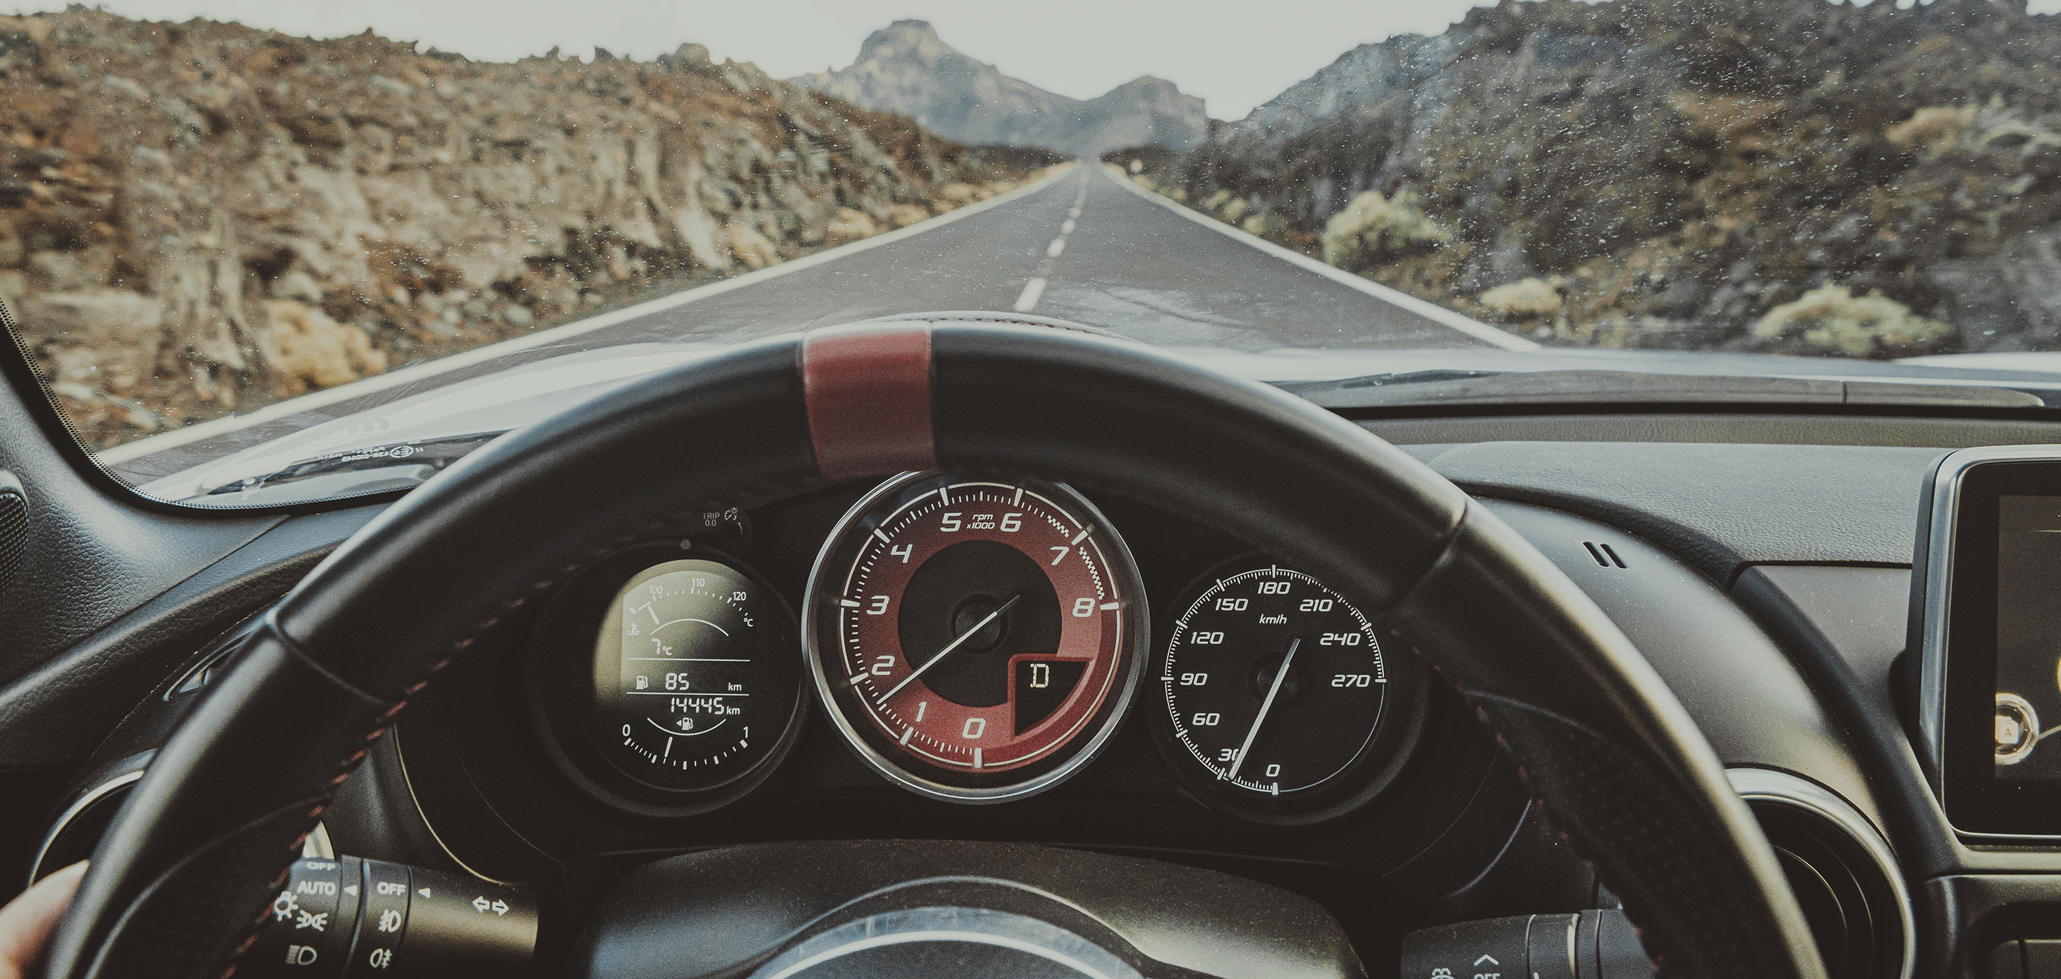

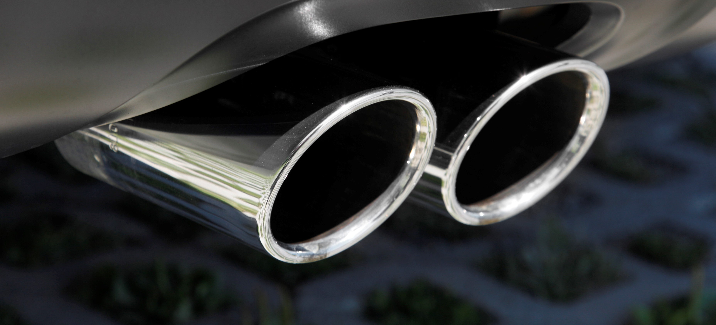



Slide 2
Agenda
Goals
Baseline
Strategy 1
Strategy 2
Strategy 3
Revenue Comparison
Cost Comparison
Gross Profit Comparison
Recommendation
Questions

Slide 3
Goals
Minimize costs
Maximize revenue

Slide 4
Baseline
Baseline | Baseline
Total Revenue | $ 52,830,207.00
Total Cost | $ 30,320,297.92
Gross Profit | $ 22,509,909.08

Slide 5
Strategy 1: Remove Unprofitable Cars
Unprofitable cars are costing Lariat $(96,313.50)
Outcomes:
Decreases Revenue
Decreases Cost
Increases Profit

Slide 6
Strategy 2: Add Renault Cars
Renault has the highest average profit of all car makes in the Lariat fleet - $7,857.57
Outcomes:
Increases Revenue
Increases Cost
Increases Profit
All slides pertaining to this strategy assume 50 cars.

Slide 7
Strategy 3: Replace Unprofitable Cars with Renault Cars
Outcomes
Increase Revenue
Decrease Cost
Increase Profit

Slide 8
Revenue Comparison
Percentage Change: Revenue
Strategy 1 | -1.4%
Strategy 2 | 0.5%
Strategy 3 | 1.2%

Slide 9
Cost Comparison
Percentage Change: Cost
Strategy 1 | -2.8%
Strategy 2 | .04%
Strategy 3 | -2.6%

Slide 10
Gross Profit Comparison
Percentage Change: Profit
Strategy 1 | 0.4%
Strategy 2 | 1.2%
Strategy 3 | 6.2%

Slide 11
Recommendation
STRATEGY 3: Meets all business objectives
Increases revenue and decreases costs.
Strategy 3
Total Revenue | 1.2%
Total Cost | -2.6%
Gross Profit | 6.2%

Slide 12

Questions

